Slide 1
Exploring mHealth Devices for Health Technology Instruction
Florida Health Sciences Library Association
April 4, 2014
Orlando, FL
Notes:
Opening remarks—thank you for the invitation to speak
I had the opportunity to discuss this breifly at ALA in Chicago last summer—in the LITA Lightening round session….but only had about 7 minutes to talk…not much time to really cover all that I wanted to about mhealth devices—specifically—the wearable activity trackers….needless to say, I ran out of time before I had discussed all that I planned…so its nice to be here and have just a little bit more time to discuss some of my observations about these devices and about some of the underlying technology trends. Additionally, I’d like to talk about where these devices might help us as health sciences librarians—and what we can do with them.

Slide 2
Curious Trends
Wearable Technology
The Quantifed Self
Notes:
So, as the technology coordinator for the SE/A regional medical library, one of my unofficial responsibilities as I’ve come to understand it, is to be curious. Specifically about tech trends. I’m to find them and and be curious.about them. Ask why these things are so curious and why I should care. Being curious is hard work and takes a good bit of time—a lot of it reading about curious things others have dug up to write about. I’ve gone to conferences to hear about what makes others curious. And sometimes I get to share with others what I’ve been finding so curious. So here I am. And here are 2 topics I’ve recently grown curious about—wearable tech and the quantified self. Topics that are kind of related—or at least find themselves sharing a table. And its because of these topics, I decided to explore a handful of mobile consumer health technologies—so this is where we begin our discussion today. And Yes, once you get the curiousity bug, it sort of just takes over.

Slide 3
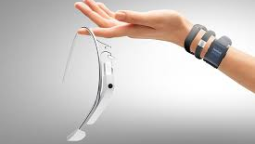
2013 Horizon Report
Wearable Technology--4-5 Years to Adoption
Notes:
My first topic of curiosity, Wearable technologies, as the name implies, are devices and sensors attached or affixed to a user's person in some way to measures any number of vitals or activities. These devices will often act as extensions of other mobile devices such as smartphones or tablets that have the ability to interpret and display the information these wearables can collect. Wearable technology devices have the potential to offer users instant access to personal health data, information about a user's surrounding or the ability to communicate and collaborate with other users.

Slide 4
Gartner Hype Cycle July 2013
Notes:
Almost a year ago, wearable user interfaces was just located just past the peak of inflated expectations, while other technologies such as mobile health monitoring was even further ahead in its projected path toward mainstream adoption

Slide 5
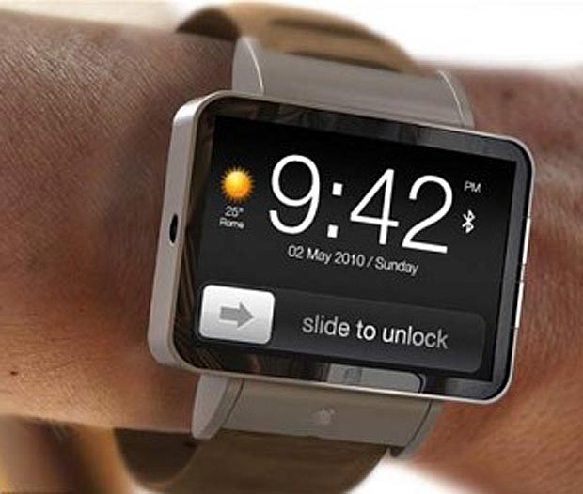
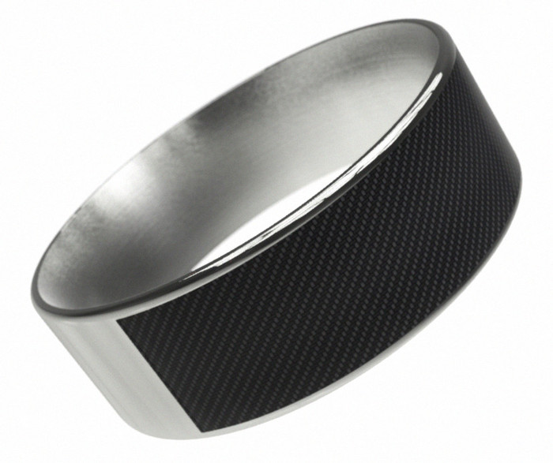
Smart Watches & Jewelry

Slide 6
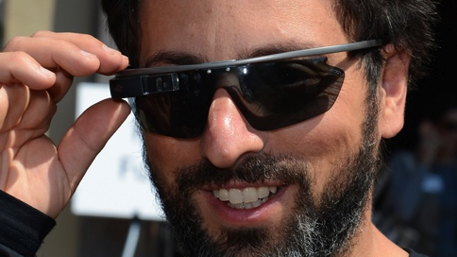
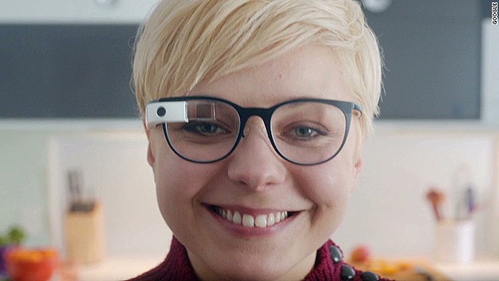
Glasses

Slide 7
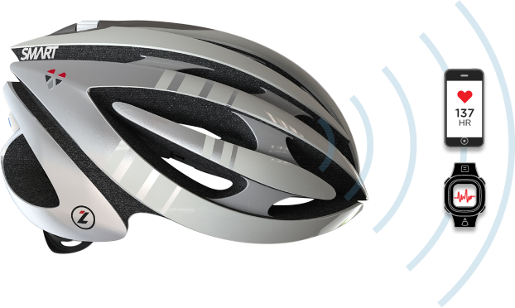
Smart Clothing

Slide 8
Activity Monitors

Slide 9
Wait a minute….
Wearable Technology? This is new??
Notes:
Yes, these are obviously new technologies aimed at providing more convenience and productivity in our work and personal lives, but this idea of wearable technology being new—is it really new? And how are these technologies different?

Slide 10
Notes:
To the uninformed bystander, the idea of “wearable technology” may not seem so new (show images of stages of wearable technologies)

Slide 14
Questions
So what’s the difference—in wearable technologies of the past and those now emerging to be a part of the future?
Are these wearable devices just clever ways to expand the reach of an existing wireless telecommunications network?
Notes:
As I’ve been exploring and researching new wearable technologies, I’ve come to ask a few questions about wearable technology in general---quesitons you may also be asking. But, lets hold these questions just another few minutes.

Slide 15
Quantified Self
Definition:
Through the use of new technologies, the collection/capture of a personal data stream that can be used to improve health, productivity, and/or relationships
2014 Horizon Report: Important technological advance with 4-5 year to adoption

Slide 16
Example of Quantified Self
Use of sleep tracking device and collection of information about daily routine such food, alcohol, caffeine consumption, lighting conditions, commute times, etc. to identify changes to improve sleep quality and well-being

Slide 17
Example of Quantified Self
Placement of sensors on everyday objects (toothbrush, watering can, dog collar, etc.) to measure and track routine living activities to identify areas where behavioral changes can be made to better attain to do items and goals

Slide 18
Some more questions…
If one were interested in this idea, specifically in regards to their personal health data, what tools were available and how accessible and easy to use were they really?
In other words, how practical an idea was QS for everyday health consumers with a range of technical aptitude?

Slide 19
Wearable Technologies + The Quantified Self
Wearable technologies: What’s new or really great about this next generation of clever devices?
Quantified Self: How accessible is this concept to the average health consumer and what role might wearable technology play?
Notes:
For brevity’s sake, my questions about wearable technology and this idea of the quantified self could be boiled down to these 2 questions…(now you’re starting to see what the 7 minutes they gave me at ALA didn’t quite cur it, right? Curiosity’s a burden)

Slide 20
Project to Explore
Identify wearable devices that can collect personal health data
Evaluate quality and function of multiple devices by simultaneously wearing devices to capture and record data
Identify ways wearable consumer health technologies might be used to promote “healthy” information access and use
Notes:
So, I came up with a project to find and evaluate some wearable devices—devices that were much more than just fun—but were also a way to start collecting my own personal data. I also wanted to see how, if any, these devices might help health information consumers—and the librarians that work to respond to their information needs.
As these topics relate to the collection of health information –and to help answer my initial questions about the significance of emerging wearable technologies

Slide 21
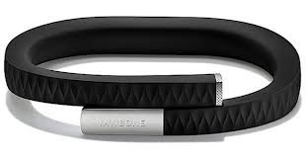
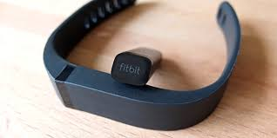
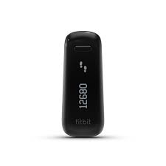
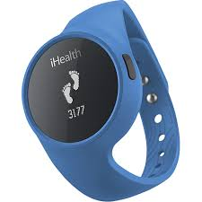
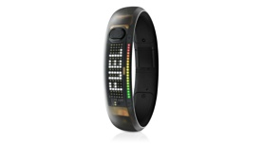
Device Identification
F
Fitbit Flex
Jawbone Up
Fitbit One
Nike Fuel
iHealth
Notes:
Slide 3: Monitors
So, about a year ago, in April, I started testing devices-- the Jawbone Up, the Fitbit One, and the iHealth watch band to see how they captured personal health data, leading health consumers to think and act with more health conscious. Along the way I've also started looking at the Nike Fuel activity band and have replaced the Fitbit One with the Fitbit flex. These represent a portion of products, apps, and devices available to consumers and just the ones I’ve chose to use in taking a look at this trend.

Slide 22
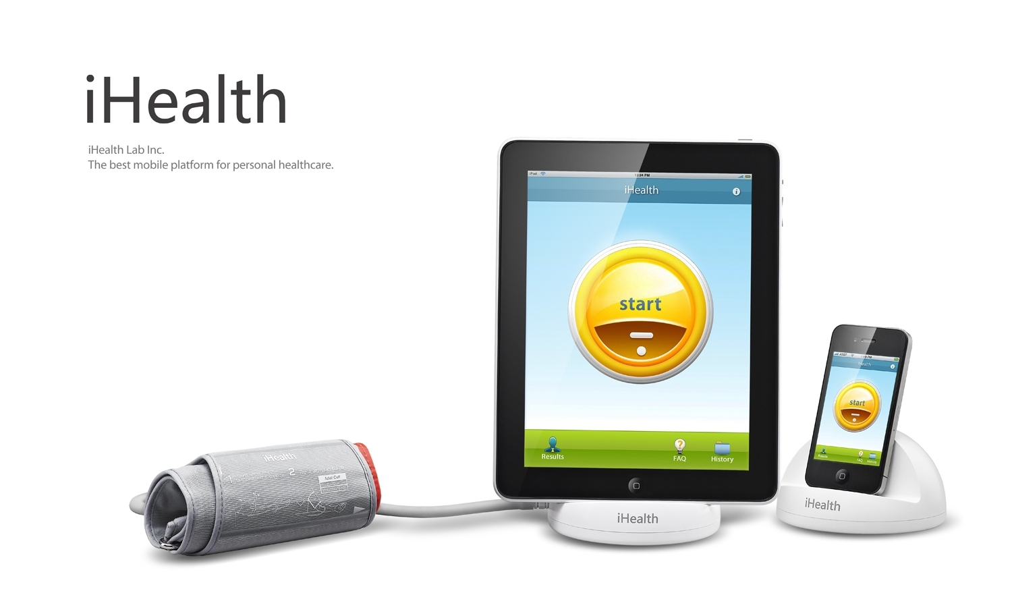
Other Devices
Notes:
I also tried out these additional devices—the ihealth blood pressure cuff and the Aria fitbit scale to capture weight and blood pressure. Although these devices worked well enough, I didn’t use them consistently enough to provide data over time.
The blood pressure cuff worked with apple devices, so the data synced well in the ihealth app and in rythum with the ihealth activity monitor. I don’t think that the cuff is as accurate a diagnostic tool as found in healthcare settings, but it does seem to be useful for folks who need to be concious about bllod pressure issues and behaviors to modify.
The aria fitbit scale works pretty good, but I found it was senstive to the surface it was placed on and gave different readings accordingly. But, the data is recorded over time on the scale for multiple users and syncs wirelessly with the fitbit application, also capturing data from the wrist monitor.

Slide 23
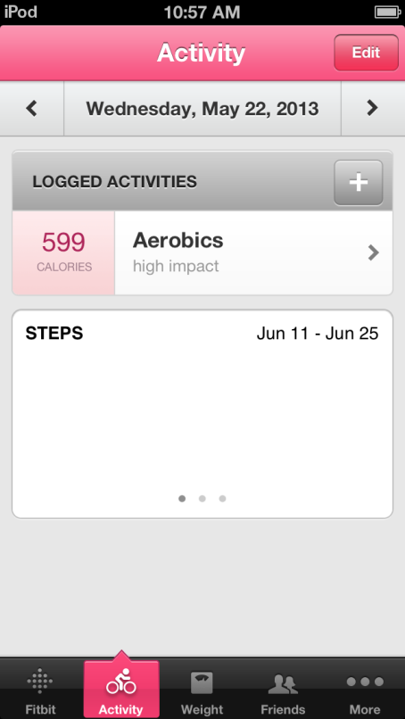
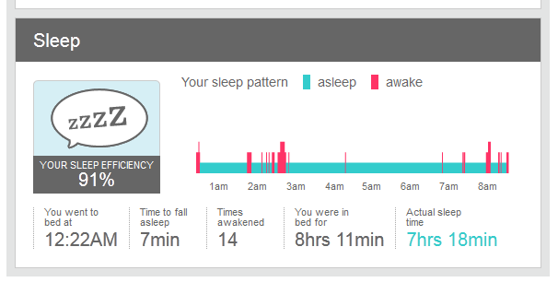
FitBits (Flex, One)
Notes:
Slide 6: Fitbits
Fitbit aimed to fulfill many of the same activity/sleep functions and enables users to sync data via Bluetooth (Up bracelet need hard connection to device and USB to charge) Fitbit allows monitors and other devices such as scales to feed data to the users personal web profile where goals, caloric consumption, sleep and other metrics are captured.

Slide 24
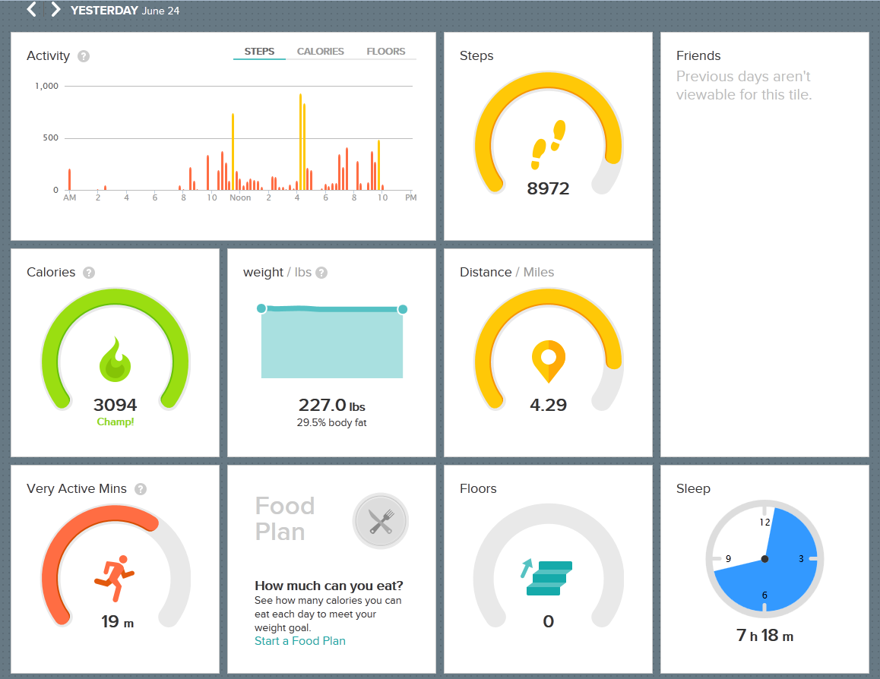
Notes:
Slide 7: Fitbit
Here's a dashboard view of my data captured on Monday this week

Slide 25
Notes:
Slide 8: Fitbit
Specific activity data show steps, calories, distance moved, as well as floors/stairs---shown here, but also a feature of Up, devices track periods of low and high activity giving users data on when activity may be increased

Slide 26
Pros/Cons--Fitbit
Pros
Well made/durable
Cost-appropriate at about 100.00
Robust mobile & web apps
Extra wristbands
Cons
Small detached pieces
Awkward design—removing/replacing fitbit
Had to tell it I was ready to sleep

Slide 27
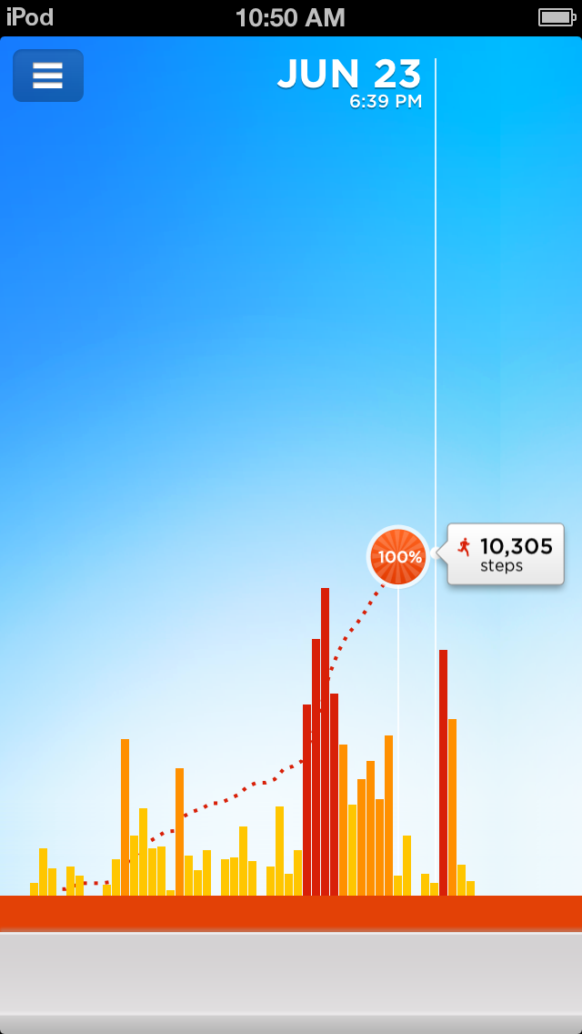
Jawbone Up
Notes:
Slide 4: Jawbone UpJawbone Up Bracelet—Cost: 129.00
Functions: Tracks steps, sleep quality (time until sleep, time in bed, times awake, total sleep, total awake, light sleep vs. deep sleep), profile settings, band calibration, team up with friends, daily news feed, smart sleep alarms, idle alert, stop watch, power nap, ability to log workout, sleep, set steps goal, sleep goal
Pros: Nice styling, most durable, comfortable, Free app; waterproof ; possibly best sleep monitor, accurate steps taken w/ ability to calibrate, share w/social media
Cons: Have to plug in to device to sync (no blue tooth); App doesn't sync with fuller featured website but does partner with other apps w/ sites like MyFitnessPal, no share via email?,
The Up bracelet by Jawbone seems to be popular and measures daily activity in steps as well as calories expended. The band also captures data about your sleep—total sleep, time in minutes until fell asleep, as well as light sleep vs. deep sleep and sleep efficiency. You can also have the Up bracelet wake you within a set time period up to 30 minutes of a light sleep cycle, to make waking up easier. Alarms and reminders can also be set to remind you to move. Data is best displayed through the mobile app—these are a few screenshots.

Slide 28
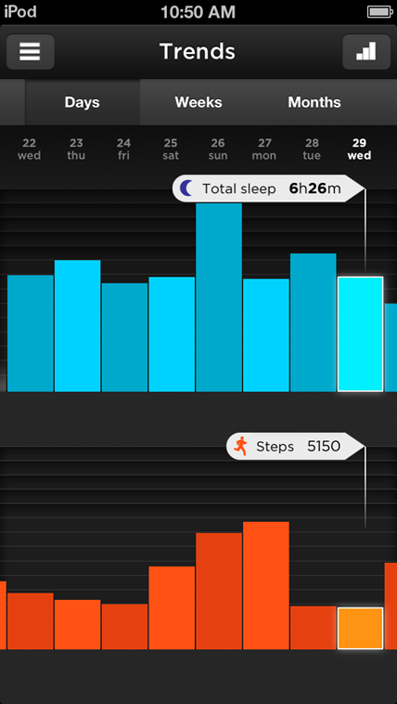

Slide 29
Pros/Cons—Jawbone Up
Pros
Stylish/confortable
Mobile App w/lots of ways to organize/display data
Preferred sleep tracker—automatic
Cons
Had to hard plug in to sync data to mobile device
Small, removable parts
No web application/ sync functionality
Very limited lifetime (2 bands died over 4 mos)
Overall poor performance

Slide 30
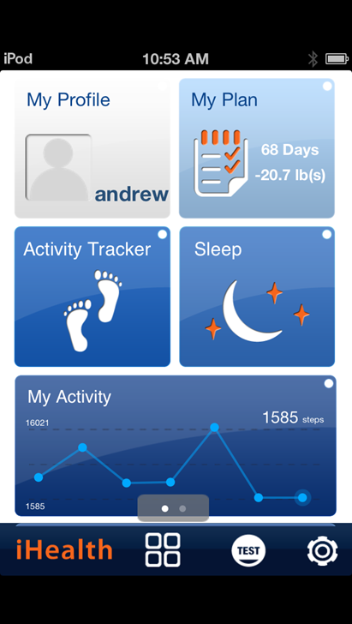
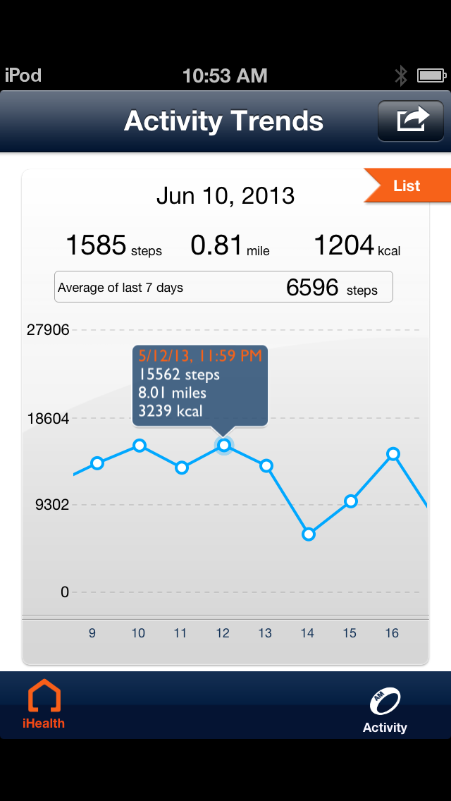
iHealth
Notes:
Slide 9: iHealth
iHealth wrist monitor—Cost: 59.99
Functions: Tracks steps taken; Sleep efficiency, duration, active vs. asleep, set goals (steps, weight loss, etc), input exercise, dietary info to calculate calorie consumption/loss, trends/analysis, manually enter weight, food, exercise, works with MyFitnessPal app (better exercise/nutrition database than health), tells time, calories burned, goal progress
Pros: Free App, full featured site, export to email, social media; App supports multiple device types—monitor, scale, blood pressure all in one, waterproof, easy to see how many steps so far/progress, also tells time
Cons: Somewhat less durable than Jawbone Up-- got scratched early/easy;
A key feature of this device was both in the time function but also knowing specific numbers of steps during the day to allow more on the spot progress checks. iHealth also uses Bluetooth and tracks much of the same data.

Slide 31
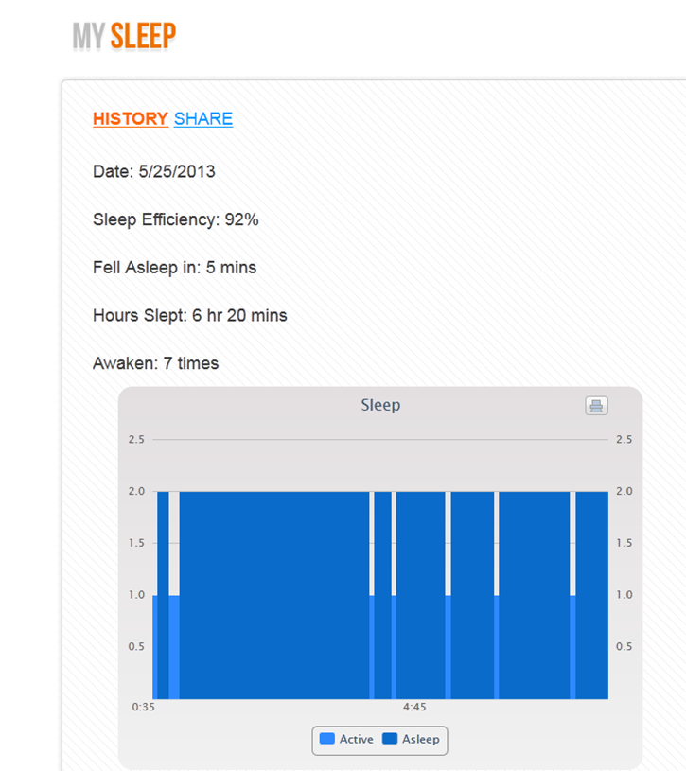
iHealth

Slide 32
Pros/Cons iHealth
Pros
Cost—least expensive at 59.00
Display with steps taken and time
Compatible with apple products and other ihealth devices (blood pressure cuff)
Compatable with MyFitnesspal App
Best website app, great mobile app
Syncs via Blue tooth
Cons
Least durable (easily scratched face)
Died after 5 months use/abuse

Slide 33
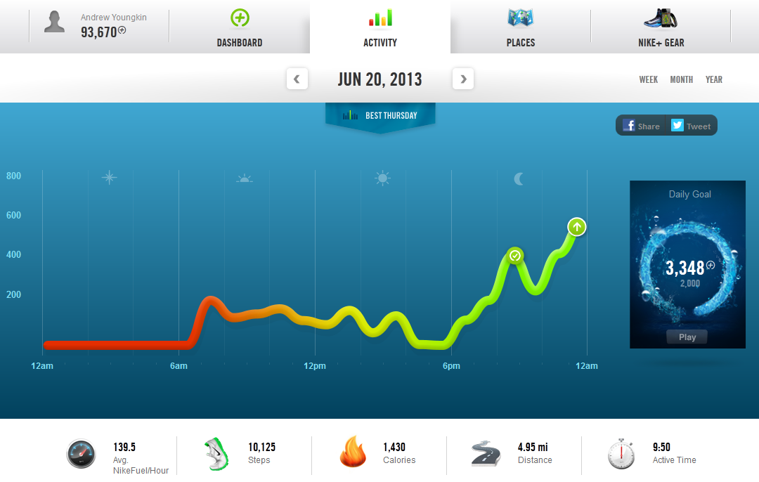
Nike Fuel
Notes:
Slide 11: Nike Fuel
I also tested the Nike Fuel bracelet, which tracks activity only, not sleep. The website is pretty cool, dynamically celebrating your accomplishments and encouraging goals. This band was very durable and obviously targets athletes. It also attempts to measure more than steps, distance, and calories, but a Nike-specifc metric, called Fuel—a number assigned to total energy expenditure—giving you Fuel points for not only running, walking, but weight training, basketball, swimming, aerobics, etc. The idea is to give you more credit for the activities you do, with out making users log every workout. Plus the Fuel number is supposed to encourage friends to challenge each other.

Slide 34
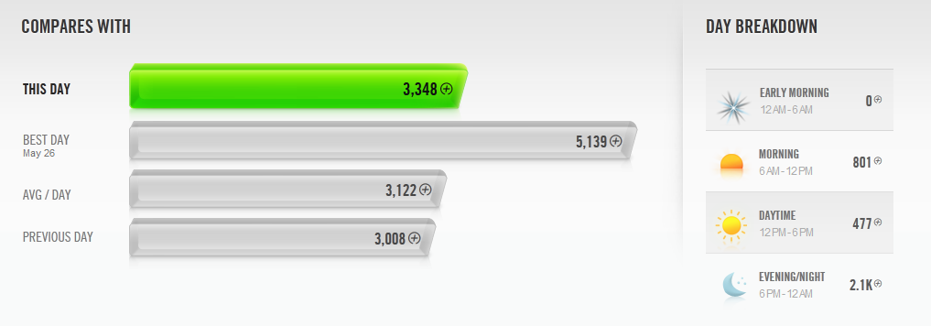

Slide 35
Pros/Cons—Nike Fuel
Pros
Includes unit of Measurement in “Fuel” points
Increased gamifying element/goal setting
Web application
Very Durable
Cons
Activity only (no sleep)
Wonky sizing feature—extra piece to enlarge
Removable pieces
Extra sensitive to water/moisture
Cost—most expensive at 170.00

Slide 36
“Best” awards
Best overall device: Fitbit Fuel
(watch style, blue-tooth enabled, durable, extended web and mobile apps, at 100.00)
Best Value: iHealth (60.00 with bluetooth, great web and mobile apps, watch style)

Slide 37
Overall Pros
All easy to set-up and get started
Easy data collection/storage
Clear data/information for activity/sleep behavioral changes
All were comfortable enough
Devices consistent over time
All worked well to set goals, track activity and help modify healthy behaviors

Slide 38
Overall Cons
Most/Many devices had quality issues (died during project, normal everyday activities)
Possibly too sensitive to water/moisure
Limited in activities tracking
Not all activity capture/account for all user activity (Yoga)
Devices mistake movement for wakefulness
Specific device designs could be improved
Non-wrist-watch style easy to loose (Fitbit One)
Sizing/fitting should be easier (Nike Fuel, Jawbone)
Syncing that requires non-wireless methods
Small detachable pieces are easy to loose
Limited/no displays

Slide 39
Considerations
Technology measuring [movement/steps], not actual calorie expenditure, heart rate/cardiovascular work, other precise health indicators—”calories burned” data is calculated/estimated—
Sleep quality estimated based on movement and doesn’t account for all sleep related disturbances
Calculated activity data relies on user reported biometrics

Slide 40
Observation: Different devices= different data
May 26 | Steps | Calories | Distance
Jawbone Up | 14,263 | 3,126 | 5.71 mi
iHealth | 15,526 | 3,384 | 7.99 mi
Nike Fuel | 12,398 | 2,135 | 6.07 mi
June 23 | Steps | Calories | Distance
Jawbone Up | 11,954 | 2,527 | 5.94 mi
Fit Bit Flex | 14,031 | 3,357 | 6.71 mi
Nike Fuel | 8,749 | 1,672 | 4.28 mi
May 25 | Time Slept | Times Awake | Fell Asleep in
iHealth | 6 hrs 20 min | 7 | 5 min
Jawbone Up | 6 hrs, 24 min | 2 | 33 min
June 14 | Time Slept | Times Awake | Fell Asleep in
Jawbone Up | 6 hrs 34 min | 1 | 11 min
Fitbit Flex | 6 hrs, 3 min | 8 | 7 min
Notes:
Slide 13: Different devices, data
I suppose a goal I've had also is judging which devices do well, hold up, and do what they say. Though the jury is still out in some regards, I've been able to start comparing how the devices collect data. In the three months of using the devices and capturing data, one observation that stands out is the differences in data that each collects. Although each device seems consistent day to day, they do not measure the same and 10,000 steps with 1 device may likely not be measured as such with another device.

Slide 41
Next: Completely Automated tracking
24/7 heart-rate monitoring
Activity
Sleep
Stress
Hydration
Automatic calorie intake/consumption via blood glucose measurement
Bluetooth enabled
Wrist-watch style
Waterproof

Slide 42
GoBe Health Tracker

Slide 43
Back to the questions
Wearable technologies: What’s new or really great about this next generation of clever devices?
Quantified Self: How accessible is this concept to the average health consumer and what role might wearable technology play?

Slide 44
Answer on Wearable Technology
Consumer health activity tracking devices are more than just extensions or reformatting of an existing technology, but become unique in their ability to capture, deliver, and integrate data and information into the most ideal, valuable situations/contexts
If the user chooses to act on it, these devices could provide enough personal data to influence healthy decision making

Slide 45
Answer on the Quantified Self
Yes, with the right devices built to sustain 24/7 use and various conditions, everyday users could use health tracking devices to successfully capture data to help make an informed health/behavior changing decision

Slide 46
Library Role: Healthcare workers
Explaining features/limitations of devices
Assistance choosing devices for outreach or research projects
Device set-up
Data collection methods/analysis

Slide 47
Library Role: Advise Consumers
How devices work and limitations
Best devices/apps to try based on function
Devices not equivalent to mainstream healthcare diagnostic equipment
Devices are not created equally
Protect personal data

Slide 48
Library Role: Outreach/Instruction
Activity monitors could be useful in health sciences library instruction—especially with consumer health projects promoting increased activity/exercise, better sleep, and better diet.

Slide 49
Outreach/Instruction
Keeping track taps into emotional needs for working towards goals, challenging ourselves, others, and sharing with others
Devices are themselves reliable reminders of behavior changes people want to incur and tracking progress/ goal- setting are motivational and fun
Fun instruction—and other ways of integrating game elements into learning, make it that much more effective (Nike Flex web application)

Slide 50
Final conclusions
Consumer activity/health monitoring devices should/could/will undergo improvement in quality, design, and function to be sustainable
Devices are not comparable to professional healthcare instruments, but
Devices could be valuable tools in providing health outreach, research, and instruction

